Slide 1
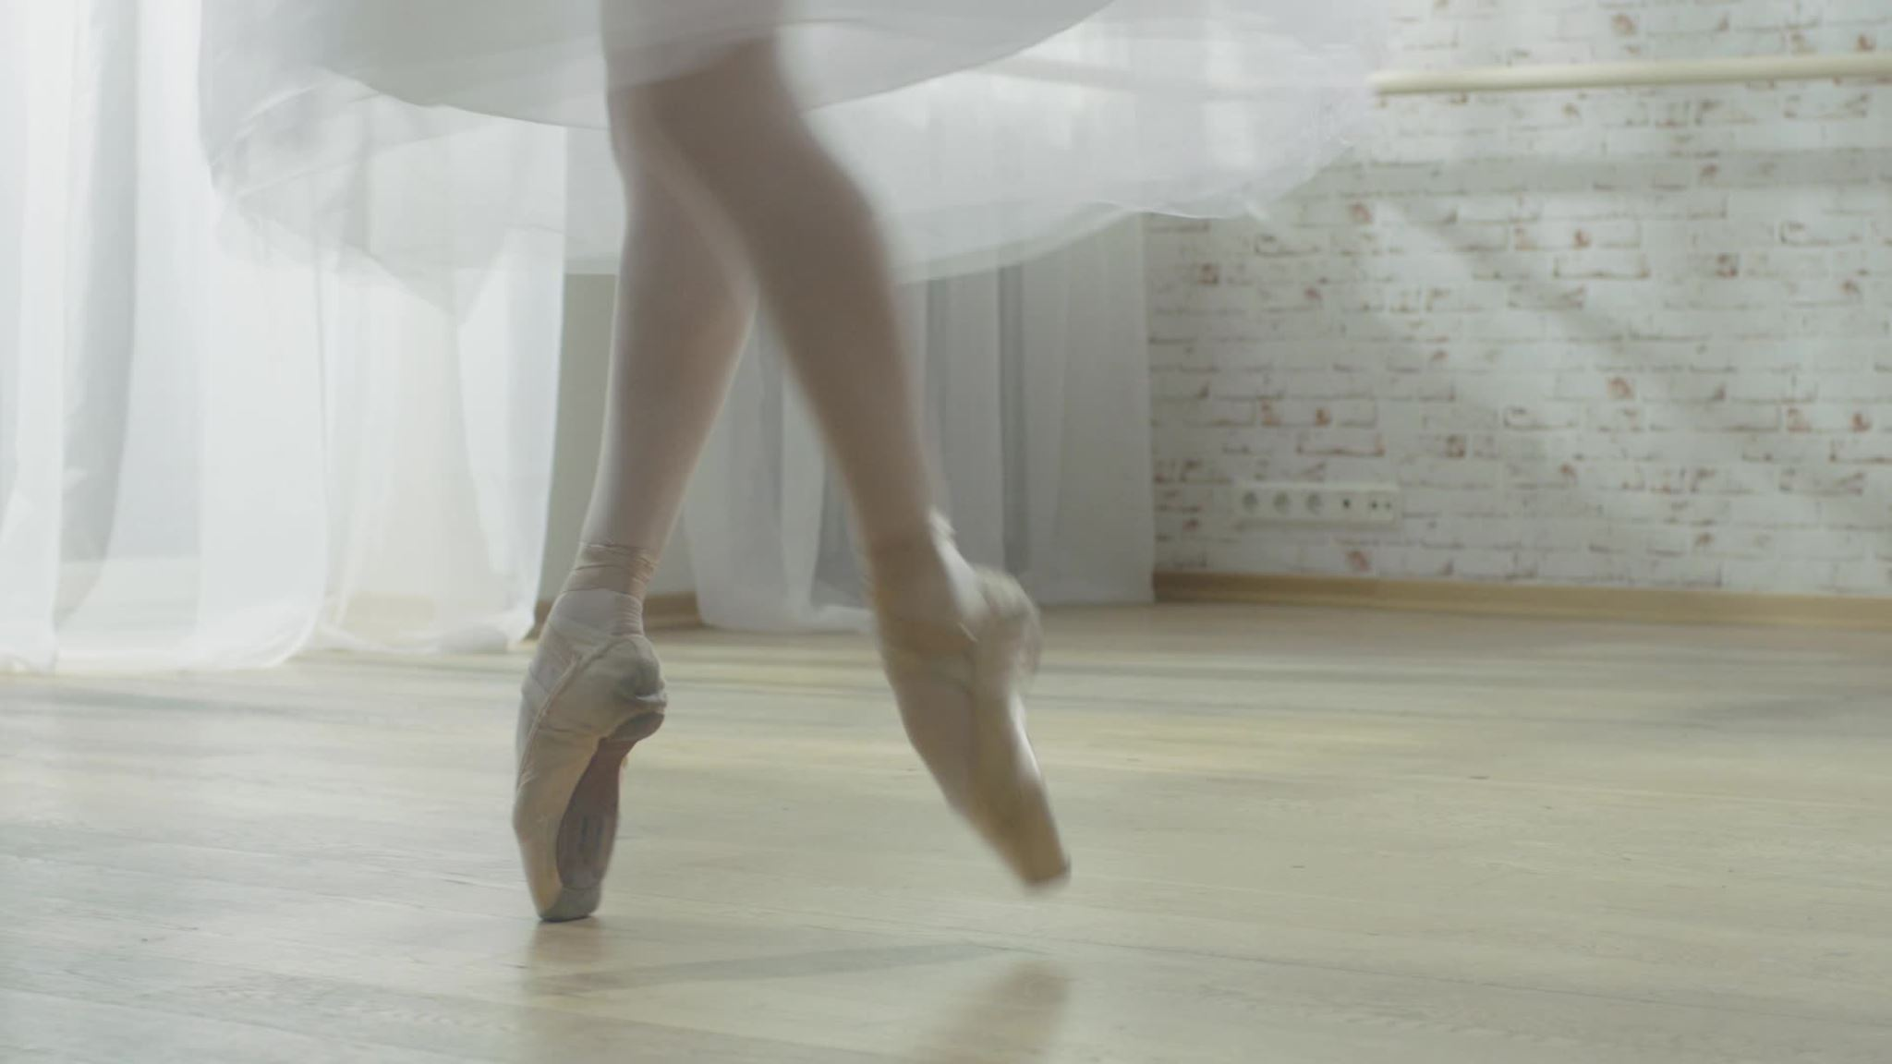
Anticipating Fine-Grained Ballet Actions: Extending AnnChor for Action Anticipation Prediction
Kayode Daniel Akilo (222007848)
University of Johannesburg
Big Data Analytics Project 2025

Slide 2
The Task - Action Anticipation Challenge
Problem Statement:
Predict the next ballet action before it occurs
Extend temporal action localization to anticipation
Use video sequences to forecast upcoming movements
Competition Relevance:
Action anticipation is an emerging computer vision challenge
Ballet provides structured, sequential movement patterns
Fine-grained prediction requires sophisticated temporal modelling
Key Challenge:
Learn from current movement context to predict future actions
Handle rapid transitions and subtle preparatory movements

Slide 3
Similar Work - Related Research
Temporal Action Localization:
AnnChor dataset established fine-grained ballet action detection
Course-Fine Networks achieved 11.09% mAP on AnnChor260 subset
TriDet models demonstrated effectiveness in temporal boundary detection
Action Anticipation Research:
Early work focused on coarse-grained action prediction
Limited research on fine-grained movement anticipation
Most studies use short-term prediction windows
Sequence Modeling:
GRU architectures proven effective for temporal dependencies
Transformer models show promise but require large datasets
I3D features provide strong spatiotemporal representations

Slide 4
Dataset Properties - AnnChor Dataset
Dataset Overview:
1,020 high-resolution ballet performance videos
24,665 temporal annotations across 11 action classes
80-20 train-test split (816 training, 204 test videos)
Action Classes:
11 distinct ballet movements (Pirouette, Grand Jeté, etc.)
Varying durations and transition patterns
Dense temporal annotations for precise localization
Features:
Pre-extracted I3D RGB features (10 frames × 2048 dimensions)
Uniform temporal sampling for consistent representation

Slide 5
Metrics - Evaluation Framework
Primary Metrics:
Top-1 Accuracy: Proportion of correct predictions
Top-5 Accuracy: Ground truth within top 5 predictions
Per-class Accuracy: Performance across individual actions
Baseline Comparison:
Random guessing: 9.09% (11 classes)
Baseline model: 57.00% (5 epochs)
Target improvement: 65%+ accuracy

Slide 6
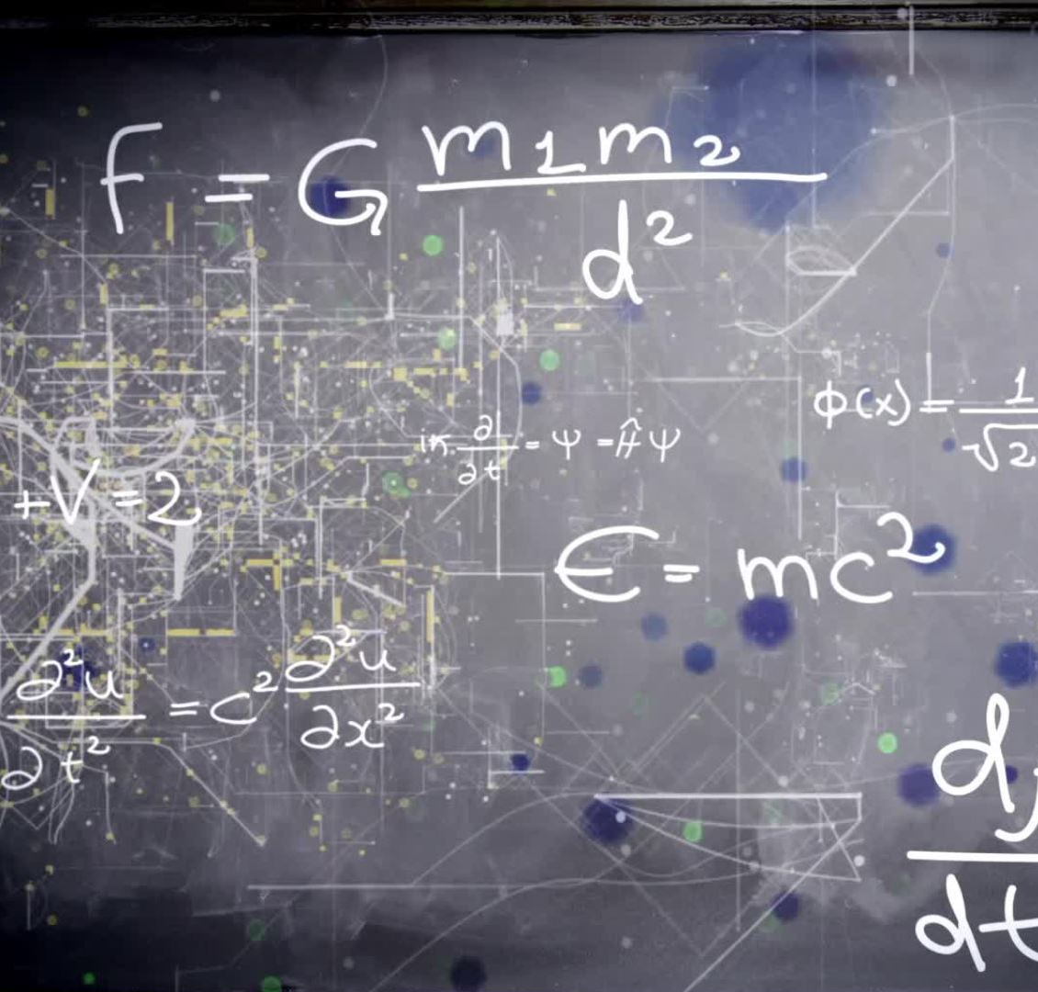
Methods - Model Architecture
GRU Architecture:
2-layer Gated Recurrent Unit (512 hidden units each)
Input: I3D features (10 timesteps × 2048 dimensions)
Output: 11-class probability distribution
Training Configuration:
Adam optimizer
Cross-entropy loss with dropout
20 epochs with learning rate decay
System Implementation:
FastAPI backend with ONNX model serving
Next.js frontend for video upload and visualization
Real-time prediction pipeline

Slide 7
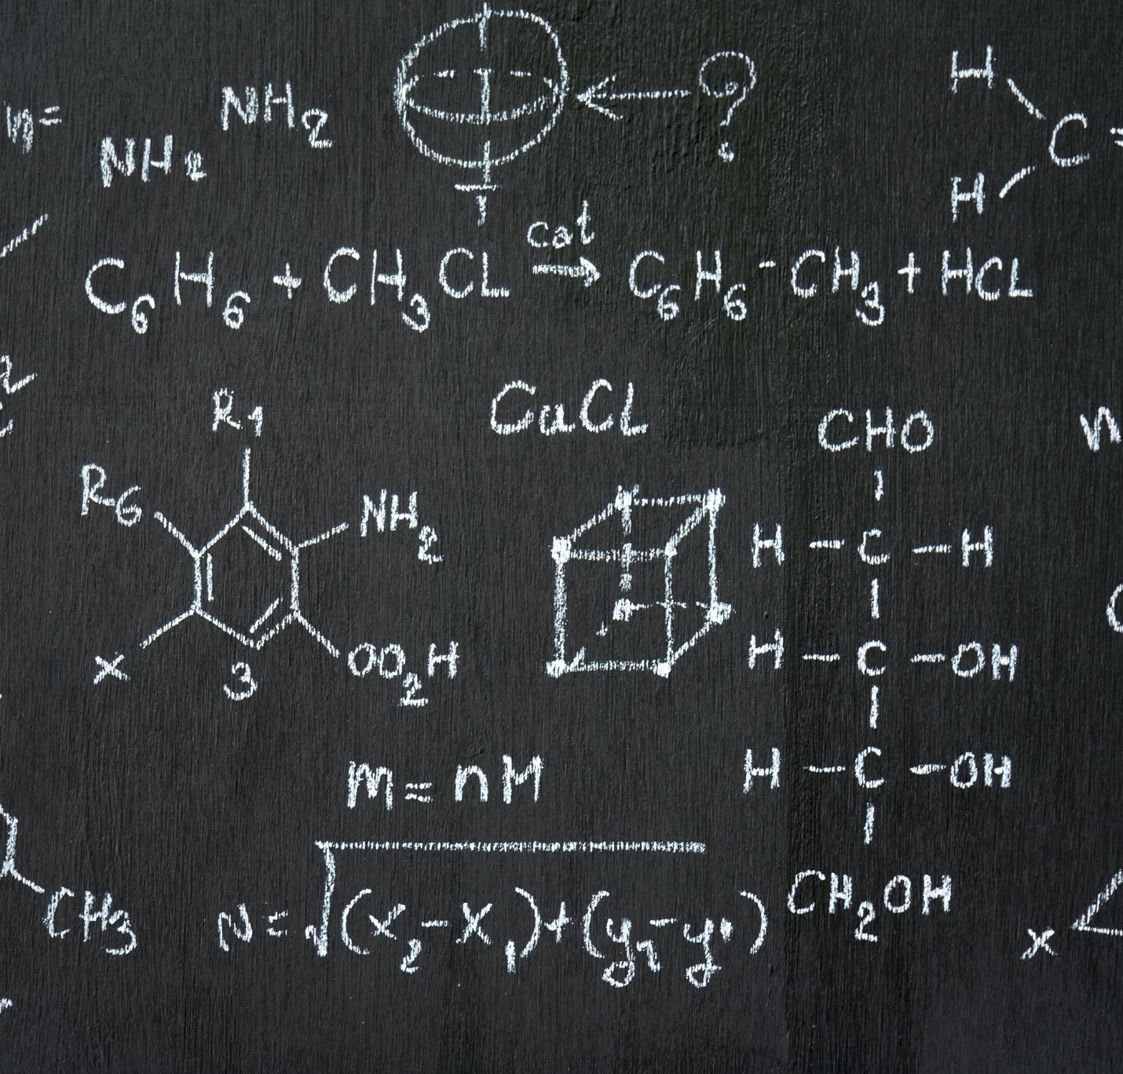
Methods - Experimental Design
Three Optimization Experiments:
Experiment 1: Extended training (20 epochs)
Baseline: 57.00% → Result: 66.32%
Improvement: +9.32 percentage points
Experiment 2: Larger model (1024 hidden units)
Result: 66.22% accuracy
Minimal improvement over 512-unit model
Experiment 3: Lower learning rate (0.0005)
Result: 66.88% accuracy
Best performance achieved
Architecture Comparison:
GRU: 66.88% accuracy
Transformer: 52.57% accuracy
GRU superior for this task

Slide 8

Results - Performance Analysis
Overall Performance:
Best Model Accuracy: 66.88%
Top-5 Accuracy was implemented for valuable insights
Improvement over baseline: +9.88 percentage points
Per-Class Performance:
High-performance actions: more accuracy
Challenging actions: less accuracy due to amount of training data
Training Dynamics:
No overfitting observed
Consistent validation performance

Slide 9

Results - System Performance
Computational Efficiency:
Inference time: <1s per prediction
End-to-end processing: 3-5 seconds per video
Deployment Metrics:
API response time: 150ms (features), 5s (video)
Memory usage: reduction with ONNX
User Experience:
Intuitive web interface
Real-time video playback with predictions
Top-5 predictions with confidence scores

Slide 10

Conclusion - Achievements
Research Contributions:
Successfully extended AnnChor from localization to anticipation
Demonstrated 66.88% accuracy on fine-grained action prediction
Established baseline for ballet action anticipation research
Technical Achievements:
Optimized GRU architecture for temporal sequence modelling
Implemented complete end-to-end prediction system
Achieved practical deployment with real-time performance
Methodological Insights:
Extended training duration crucial for performance
Learning rate optimization more important than model size
GRU architecture well-suited for choreographic sequences

Slide 11

Conclusion - Future Work
Potential Improvements:
Larger training datasets for enhanced generalization
Multi-modal features (music + temporal actions)
Attention mechanisms for complex sequences
Applications:
Choreographic analysis and education
Dance performance evaluation
Interactive learning systems
Research Impact:
Foundation for fine-grained action anticipation
Methodology applicable to other sequential domains
Open-source implementation for community use

Slide 12
Live System
System Components:
Backend: FastAPI server with ONNX model
Frontend: Next.js web application
Pipeline: Video → Features → Prediction → Display
Live Demonstration:
Upload ballet video
Real-time prediction updates
Confidence visualization
Top-5 action probabilities
Technical Stack:
Python (FastAPI, ONNX Runtime)
TypeScript (Next.js, React)
OpenCV (video processing)

